Slide 1
AI for Embedded Computing
Toward Low-power Edge Inference
Hossein I. Rad Ph.D. Candidate, IST, The University of Tokyo May 2019, MLT + ARM Tokyo

Slide 2
In this event we talk about the promise of light-weight artificial deep neural networks for energy-efficient and low-cost IoT applications. We discuss some examples of accelerated and low-memory version of Deep NNs for real-time application, time-series Analysis and demand forecast.

Slide 3
TOC
Introduction
Hardware
IIoT and Applications
Microcontrollers
Future of AI + HW
Accelerated AI + HW
Lightweight Deep Neural Networks
uTensor
Use Cases

Slide 4
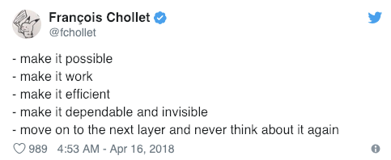
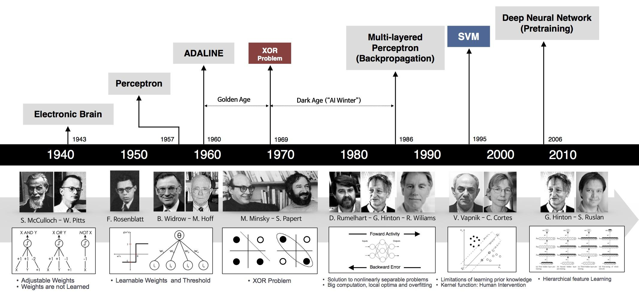
Introduction
We’d been stuck in the first two stages for many decades.
Image Source: Unknown

Slide 5
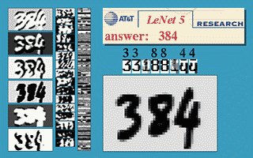
A Brief History
Speed and efficiency weren’t nearly as important as getting things to work in first place.
Main ideas behind deep learning have been in place for decades, it wasn’t until data sets became large enough and computers got fast enough that their true power could be revealed.
GPUs, increased computational speeds by 1000 times over a 10 year span.
By 2011, speed of GPUs had increased significantly
Making it possible to train CNNs without layer-by-layer pre-training
Widespread adoption of online global services, mobile smartphones, and GPS by the end of 1990s, internet companies such as Google, Amazon, Microsoft, and Yahoo! began to amass huge amounts of data in the form of audio, video, text, and user logs.

Slide 6
A Perfect Storm: Behind AI’s Recent Success
Synergistic combination of insights from optimization, traditional machine learning, software engineering, integrated circuit design, and serious sweat equity from a dedicated group of researchers and engineers.
Remarkable progress in AI has been made possible by bringing together:
Massive amounts of data
Scalable computer and software systems
Broad accessibility of these technologies
These trends have allowed core AI algorithms and architectures to be explored in problem domains of unprecedented scale and scope.
Deep learning
Reinforcement learning
Bayesian inference

Slide 7
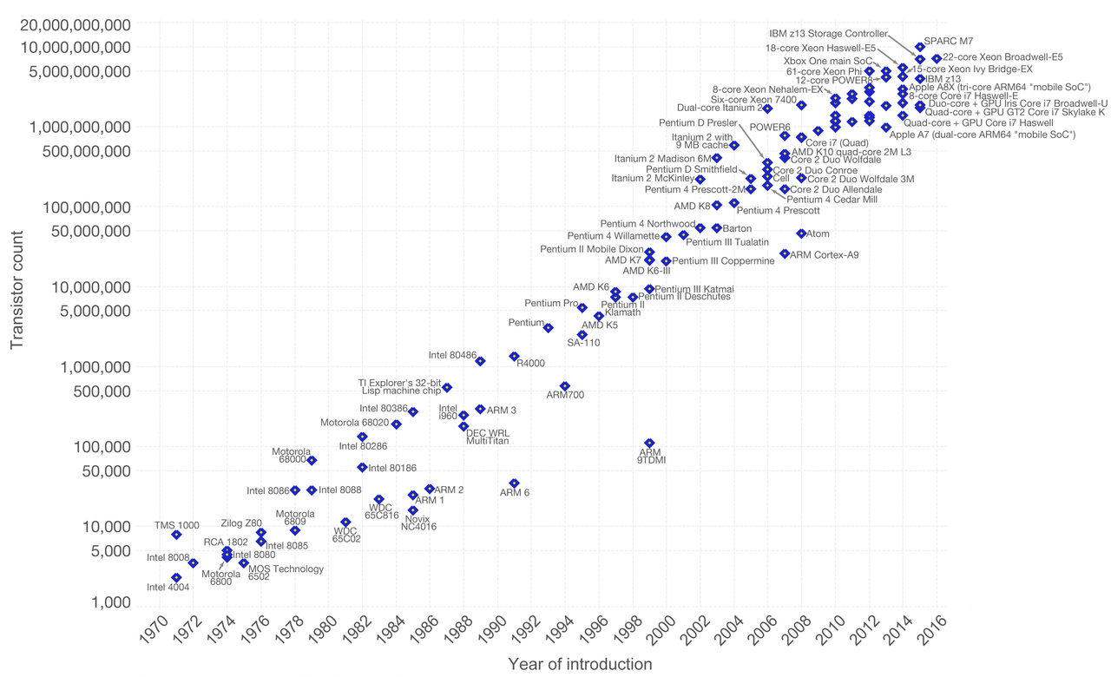
How about Hardware?
Hardware world is feeling tremors.
Increased computational power that is making all this possible derives
Moore’s law
Realization in late 2000s that GPUs were 20 to 50 times more efficient than traditional CPUs for deep-learning computations.
Nvidia’s vast majority of the growth comes from deep learning by far.
Intel purchased Nervana Systems and Movidius, two startups that make technology tailored for different phases of deep-learning computations.
Google is using its own tailor-made chips, or TPUs, to implement applications trained by deep learning.

Slide 8
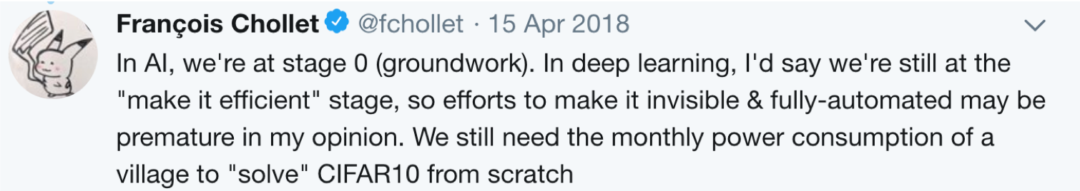

Slide 9

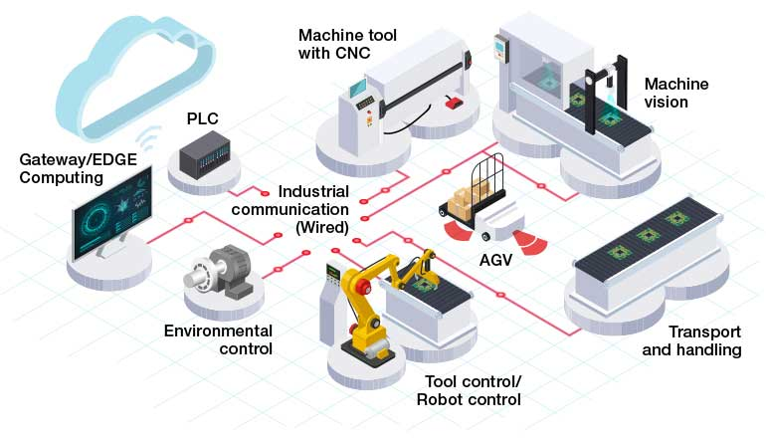
IIoT and Smart Factories:
Toward Industrial Revolution V. 4
IIoT, Smart Manufacturing or Industry 4.0: a new phase in Industrial Revolution that focuses heavily on interconnectivity, automation, machine learning, and real-time data.
Better connected ecosystem for companies that focus on manufacturing and supply chain management.
People
Sensors
Data
Machines

Slide 10
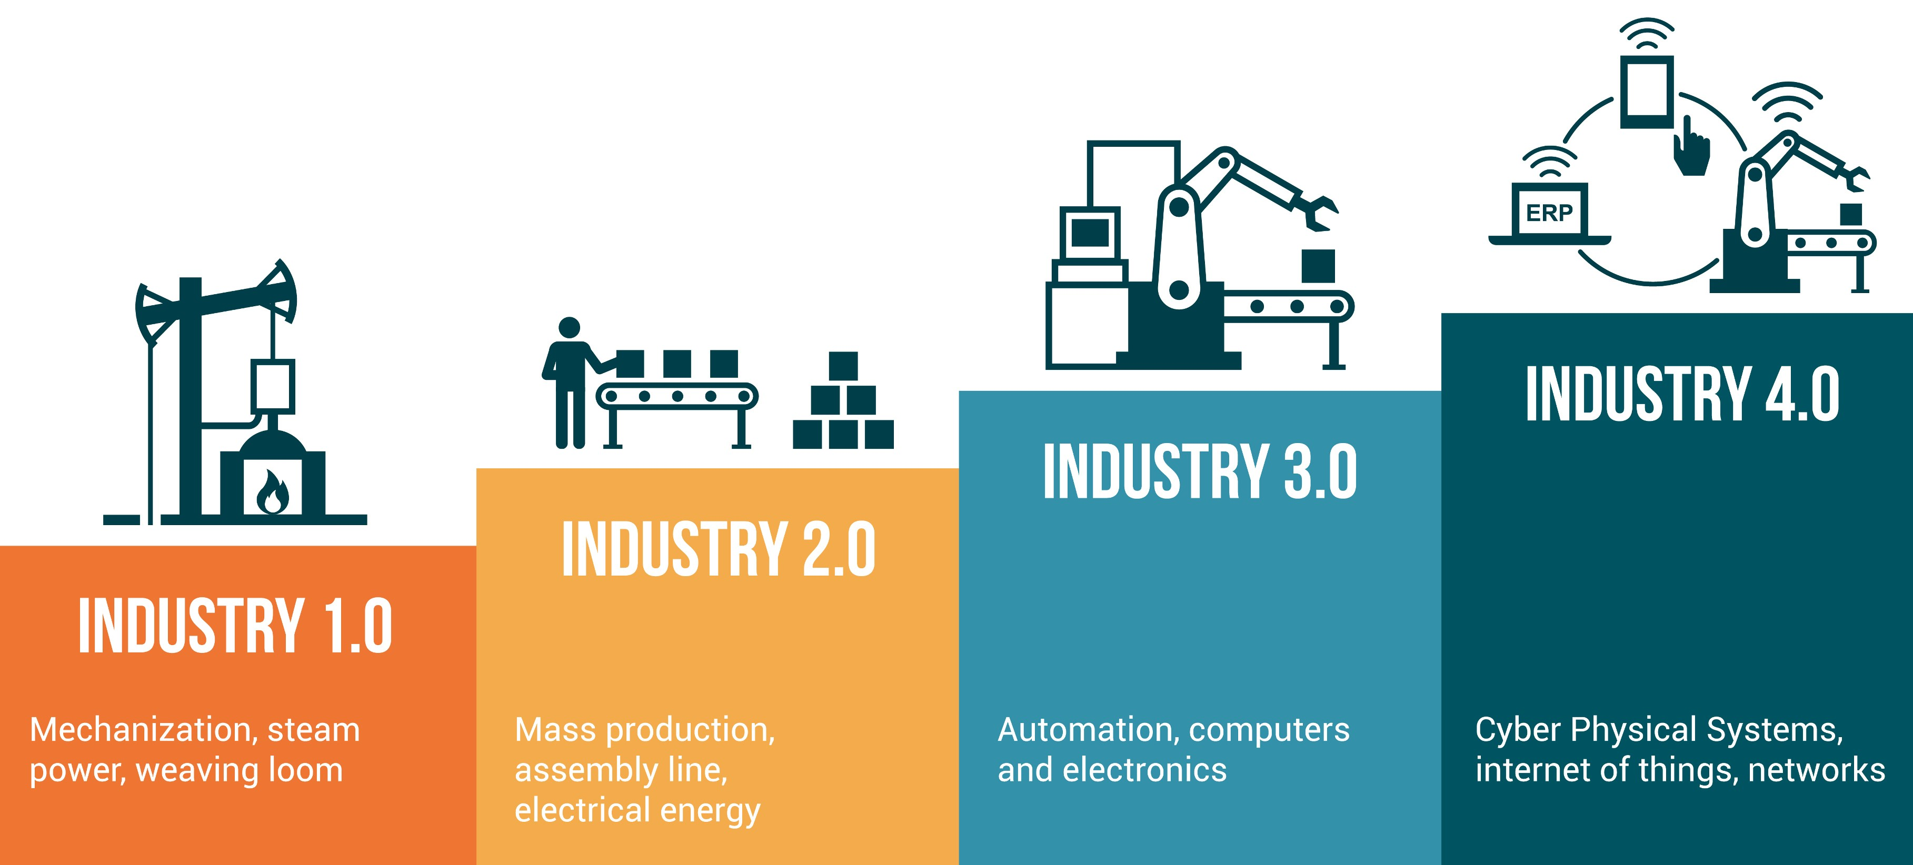
Toward IIoT
Notes:
First Industrial Revolution:
Late 1700s to early 1800s: use of water and steam-powered engines and other types of machine tools.
Second Industrial Revolution:
20th century: electricity enabled manufacturers to increase efficiency and helped make factory machinery more mobile.
Third Industrial Revolution:
Late 1950s: incorporating more electronic and computer technology into their factories.
Shift that put less emphasis on analog and mechanical technology and more on digital technology and automation software.

Slide 11
Industry 4.0
More comprehensive, interlinked, and holistic approach to manufacturing.
Interconnectivity through the Internet of Things (IoT)
Access to real-time data
Introduction of cyber-physical systems
Connects physical with digital, and allows for better collaboration and access across departments, partners, vendors, product, and people.
Empowers business owners to better control and understand every aspect of their operation.
Leverage instant data to boost productivity, improve processes, and drive growth.

Slide 12

Smart Manufacturing Use Cases
Supply chain management and optimization
Solutions give businesses greater insight, control, and data visibility across their entire supply chain.
Companies can deliver products and services to market faster, cheaper, and with better quality to gain an advantage over less-efficient competitors

Slide 13
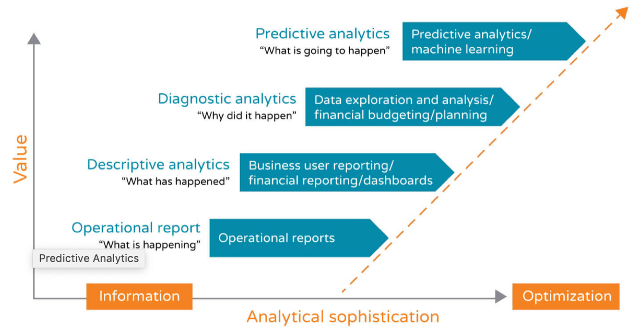
Smart Manufacturing Use Cases
2. Predictive maintenance/analytics
Ability to predict when potential problems are going to arise before they actually happen.
Manual task: Without IoT systems in place at your factory, preventive maintenance happens based on routine or time.
With Iot, sense when problems are arising or machinery needs to be fixed.
https://www.epicor.com/en-us/resource-center/articles/what-is-industry-4-0/

Slide 14

Smart Manufacturing Use Cases
3. Asset Tracking and Optimization
More efficient with assets at each stage of the supply chain
Keep a better pulse on inventory, quality, and optimization opportunities relating to logistics.
Better visibility into their assets worldwide.
Asset transfers, disposals, reclassifications, and adjustments can be streamlined and managed centrally and in real time.
https://www.forbes.com/sites/louiscolumbus/2018/06/11/10-ways-machine-learning-is-revolutionizing-supply-chain-management/#48f120833e37

Slide 15
Benefits of IIoT
Asset Tracking and Optimization entire product life cycle and supply chain:
Design, sales, inventory, scheduling, quality, engineering, and customer and field service.
Makes company competitive, especially against disruptors like Amazon.
Makes company more attractive to the younger workforce.
Makes teams stronger and more collaborative.
Address potential issues before they become big problems.
Trim costs, boost profits, and fuel growth.

Slide 16
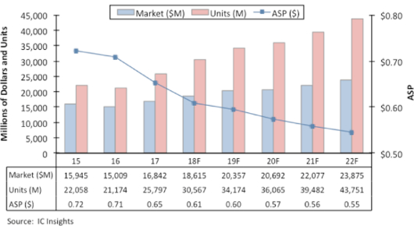
Global Embedded Systems Market Share Revenue To Surge To $124B in 2024
A broad uptake of microcontrollers (MCUs) for embedded control, for use with sensors, and with the Internet of Things (IoT) is propelling the market forward and it is expected to be worth $20.4 billion in 2019.
In 2017 unit shipments surged by 22 percent and strong growth has continued in 2018.
Annual unit growth is expected to be 18.5 percent in 2018 with the unit volume reaching nearly 30.6 billion, while market value will increase by 10.5 percent, reflecting diminishing average selling price (ASP). Revenue growth in 2019 is expected to be 9.4 percent to about $20.4 billion.
https://www.eenewsanalog.com/news/mcu-market-reach-20-billion-2019

Slide 17
Microcontrollers (MCUs)
Some of the Major Embedded Systems Market Players:
Arm holdings
Toshiba Corporation
NXP Semiconductors N.V.
Fujitsu Limited
Broadcom Limited
Analog Devices Inc.
Cypress Semiconductor Corporation
Qualcomm Technologies Incorporated
STMicroelectronics N.V.
Microchip Technology Incorporated
Texas Instruments Incorporated
Renesas Electronics Corporation
Infineon Technologies AG
and Intel Corporation.
MCUs top applications:
Smartcard
Embedded System
Automated Control
Sensing and Signal Processing
IoT
Main industries:
Automotive
Telecommunication
Healthcare
Industrial
Consumer Electronics
Military and Aerospace

Slide 18
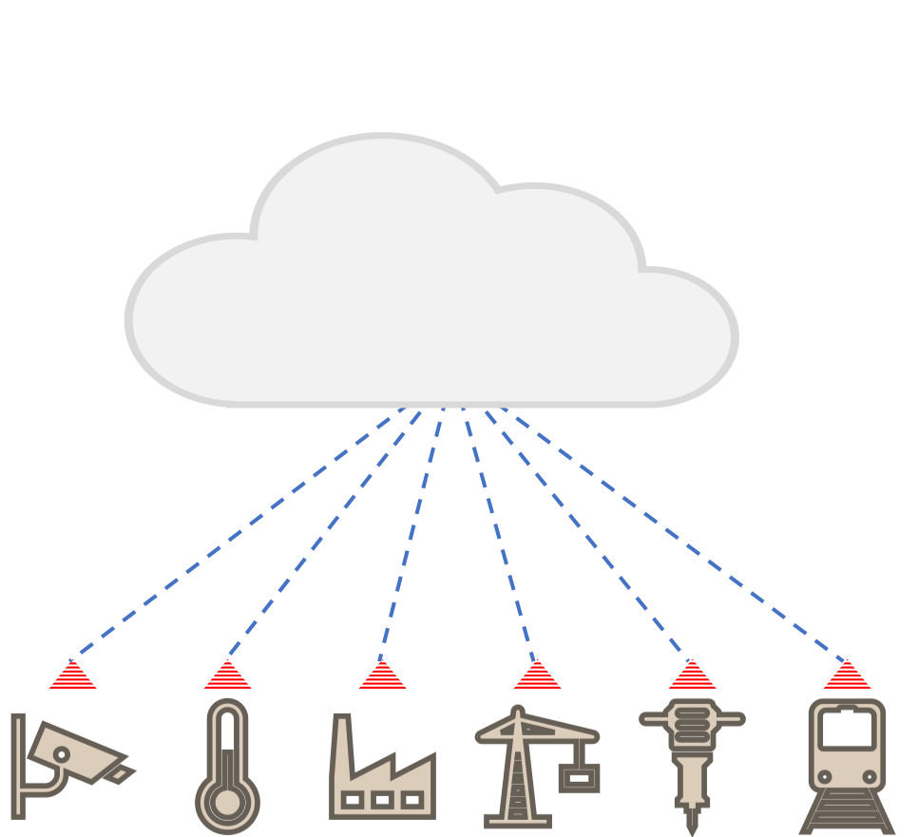
IIoT Data Glut
High-performance AI
Boost throughput -> Lower latency
Problem
Too many devices,
Uploading too much data
Too frequently
Low Power AI
Transform data raw data Into compact insights

Slide 19
Pete Warden: Why the Future of Machine Learning is Tiny?
A few years ago:
The main challenge was to change to deep learning and convince people that it is a real revolution, not a fad.
The only barrier to seeing it deployed more widely was how long it takes to get from research to deployment.
Today:
Machine learning can run on tiny, low-power chips, and that this combination will solve a massive number of problems we have no solutions for right now.
Tiny Computers are already cheap and everywhere.
https://petewarden.com

Slide 20
Building Machine Learning Applications Need out AI Chips
The rise of machine learning (to be more specific deep learning) has changed the hardware needs.
There are a lot of new applications that are blocked from launching because we don’t have enough computing power.
Many other existing products would be improved if we could run models that require more computing power than is available.
Cloud, mobile device, or even embedded systems

Slide 21
Speech Recognition Example
After heroic efforts, a team at Google was recently able to squeeze server-quality transcription onto local compute on Pixel phones.
The model itself is comparatively small too, at just 80 MB.
This network is pushing the limits of what a modern application processor on a mobile device can manage.
That means if we could offer the same level of raw compute in a chip for lower energy and a cheaper price, this sort of general speech recognition could be added to almost any product
https://petewarden.com
https://ai.googleblog.com/2019/03/an-all-neural-on-device-speech.html

Slide 22
Running Additional Neural Networks to Improve the Overall Accuracy
Cocktail party effect:
“Looking to Listen at the Cocktail Party”, in SIGGRAPH 2018.
Can get even more context from visual sensors by looking at things like gaze direction, which, again, require more deep learning models to calculate.
Improvements in latency and energy usage when running networks would translate directly into new or enhanced user experiences.
By looking at a time profile of these networks we see almost all the time is going into multiply-adds.
Improving HW improves its ability to run the arithmetic primitives efficiently.
https://ai.googleblog.com/2018/04/looking-to-listen-audio-visual-speech.html

Slide 23
The Biggest Need Over Next Few Years...
?

Slide 24
The Biggest Need Over Next Few Years...
Many believe biggest need over the next few years is for inference hardware, not training.
“Training scales with the number of researchers, inference scales with the number of applications times the number of users“.
Popular applications have hundreds of millions of users:
Each application can require many models
Therefore, scale of inference calculations can easily grow much faster.
Even cloud applications have compute budgets driven by economic costs of running servers.
Other devices usually have hard limits on the resources available.
https://petewarden.com/2019/04/14/what-machine-learning-needs-from-hardware/

Slide 25
Hardware Acceleration
Some existing ML workloads, almost all of the time goes into just a few operations, and so design an accelerator that speeds up those critical-path ops.
Sometimes when an accelerator like that is integrated into a full system it often fails to fulfill its potential.
Even though most of compute for almost all models does go into a handful of common operations, there are hundreds of others that often appear.
For Example: If accelerator is across a system bus from the main CPU this can involve a lot of latency as the two processors have to communicate and synchronize with each other.
Latency can cancel out any speed advantages from using accelerator in the first place.
https://github.com/tensorflow/tensorflow/blob/master/tensorflow/lite/kernels/detection_postprocess.cc#L365

Slide 26
Hardware Acceleration
Alternatively, may direct users towards using ‘blessed’ models that will run entirely on accelerator, avoiding any of tricky custom operations.
Majority of the product teams are struggling to train their models to accuracy they require for their application.
It makes R&DS to switch to a new model and figure out how to achieve similar results within tighter constraints.
https://petewarden.com/2019/04/14/what-machine-learning-needs-from-hardware/

Slide 27
TensorFlow Lite for Microcontrollers
Dependency-free reference implementations in TensorFlow Lite
An experimental port of TensorFlow Lite aimed at micro controllers and other devices with only kilobytes of memory.
Initially aimed at MCUs and embedded systems.
Can be useful for porting ops to devices like accelerators.
Custom operations almost always involve much less compute than core accelerated ops.
grep -Ir 'REGISTER_OP("' tensorflow/core | grep -vE '(test)|(contrib)' | wc -l
A rough estimate of 1,202 operations in TensorFlow
https://github.com/tensorflow/tensorflow/tree/master/tensorflow/lite/experimental/micro

Slide 28
Low Precision Hardware Computing
It is widely accepted that eight bits are enough for running inference on convolutional neural networks.
The picture is a bit more complicated for training, and for recurrent networks:
Because both processes require addition of many small increments to stored values to achieve their results.
But at very least full thirty-two bit floating point values are overkill in every case.
Hardware inference for eight-bit precision covers a large number of practical use cases.

Slide 29
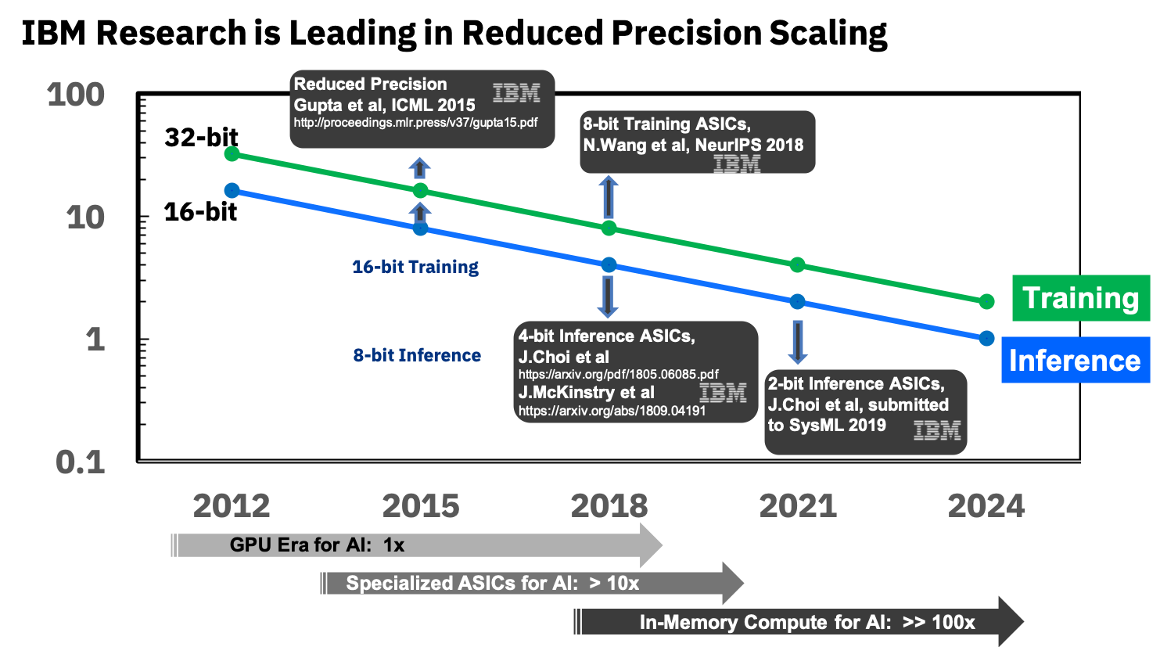
Lower Precision Hardware Computing
A lot of evidence that it’s possible to go lower than eight bits.
To build efficient models from the ground up.
Reduce the model size by applying quantization, pruning and compression techniques.
Faster inference has been achieved by having efficient kernels for computation in reduced precision.
Krishnamoorthi, R., 2018. Quantizing deep convolutional networks for efficient inference: A whitepaper. arXiv preprint arXiv:1806.08342.
https://www.ibm.com/blogs/research/2018/12/8-bit-precision-training/

Slide 30
GEMMLOWP
GEMMLOWP:
A small self-contained low-precision GEMM library
High speed and minimized power usage.
Most GEMMs are optimized primarily for large dense matrix sizes (>= 1000)
ARM with NEON (both 32bit and 64bit).
Intel x86 with SSE 4.1 (both 32bit and 64bit).
"Low-precision" means that input and output matrix entries are integers on at most 8 bits.
To avoid overflow, internally accumulate results on more than 8 bits, and at end we keep only some significant 8 bits.
Received contributions from Intel and ARM, ensuring that it is efficient on various mobile CPUs.
https://github.com/google/gemmlowp
Krishnamoorthi, R., 2018. Quantizing deep convolutional networks for efficient inference: A whitepaper. arXiv preprint arXiv:1806.08342.

Slide 31
Lower Precision Hardware Computing
MKL-DNN: Intel(R) Math Kernel Library for Deep Neural Networks.
Intended for acceleration of DL frameworks on Intel architecture and Processor Graphics Architecture.
Highly optimized implementations of computational operations used in convolutional and recurrent neural networks
Image recognition
Object detection,
Semantic segmentation
Neural machine translation
Speech recognition
https://github.com/google/gemmlowp
https://intel.github.io/mkl-dnn/index.html

Slide 32
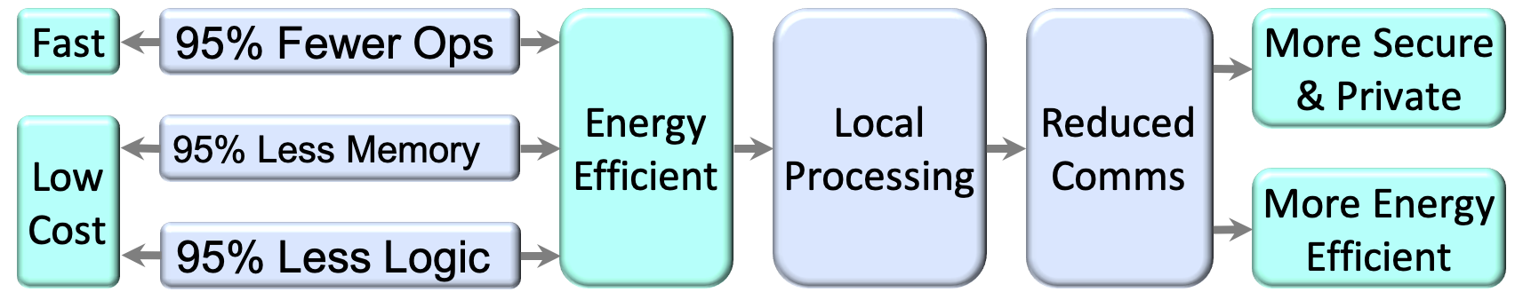
Lightweight DNNs

Slide 33
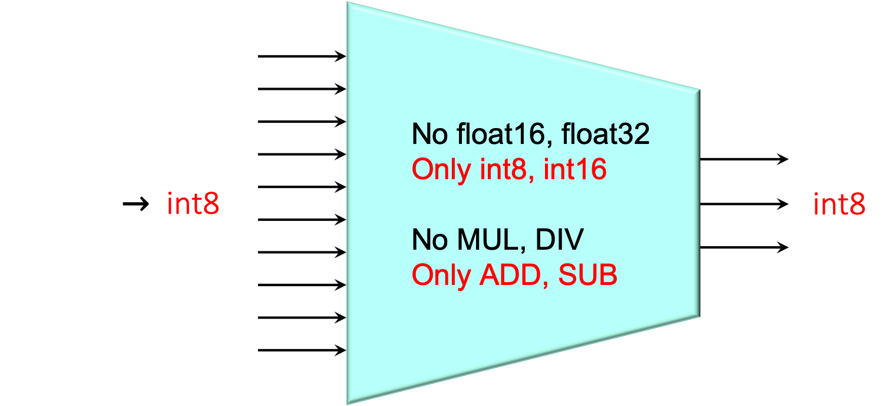
Simple Data and Simple Ops
www.infxl.com

Slide 34
LWDNNs Use Case
Deep Nets for Real-Time Applications
Fault prediction in vehicular systems
Malware detection
Replacement of a large layer in a trained conventional net with an accelerated and low-memory version
Ultra-Low Power Deep Nets for IoT
Fall-predicting wearable for seniors
Remote environmental sensor
Running-form indicator for long-distance runners
Ultra-Low Power Deep Nets for IoT
Fall-predicting wearable for seniors
Remote environmental sensor
Running-form indicator for long-distance runners

Slide 35
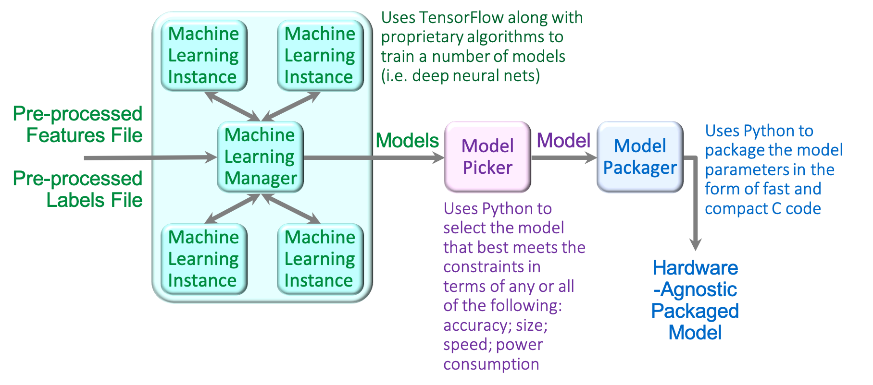
Model Development Workflow
www.infxl.com

Slide 36
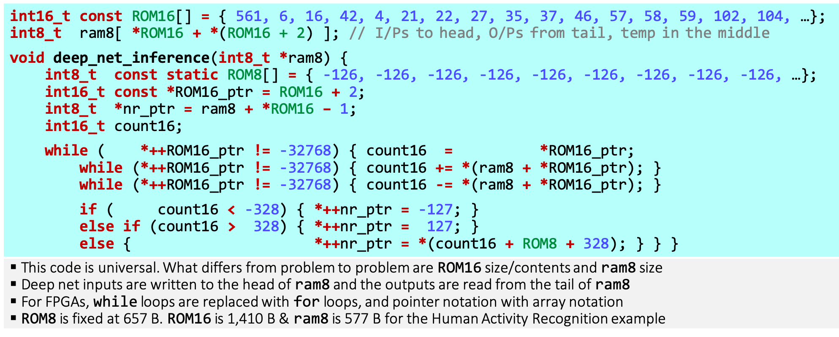
Packaged Lightweight Net in C!
www.infxl.com

Slide 37
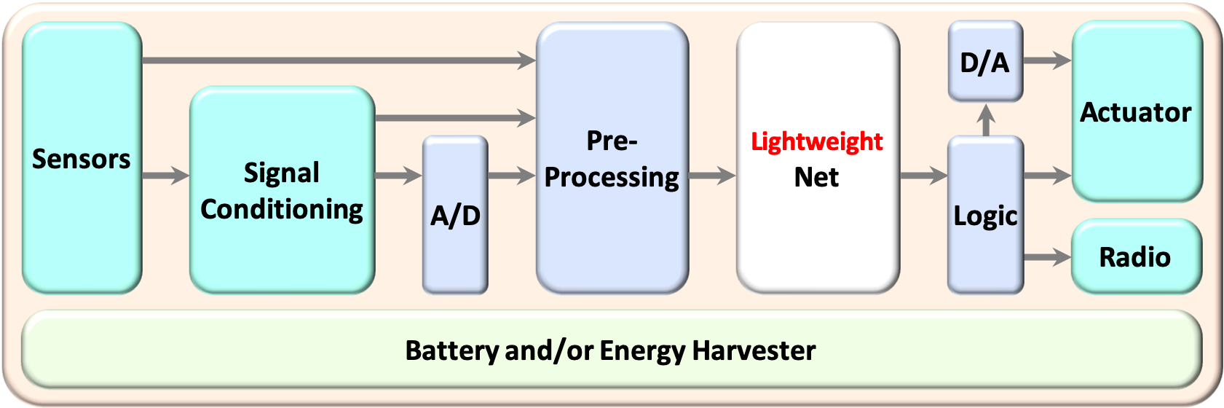
Sensor + LWDNN + Radio
Inexpensive, low-power, multi-sensor LPWAN module with built-in intelligence
Longer battery life due to reduced frequency and size of data uploads
Fast response
www.infxl.com

Slide 38

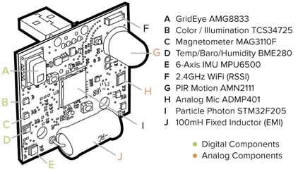
uTensor: extremely light-weight machine learning inference framework built on Mbed and Tensorflow.
Consists of a runtime library and an offline tool.
Total size of graph definition and algorithm implementation of a 3-layer MLP produced by uTensor is less than 32kB in resulting binary (excluding weights).
Runs in <256K RAM
Tensorflow compatible
Open source
http://www.gierad.com/projects/supersensor/
https://www.slideshare.net/janjongboom/machine-learning-on-microcontrollers-tech-power-summit-2018

Slide 39
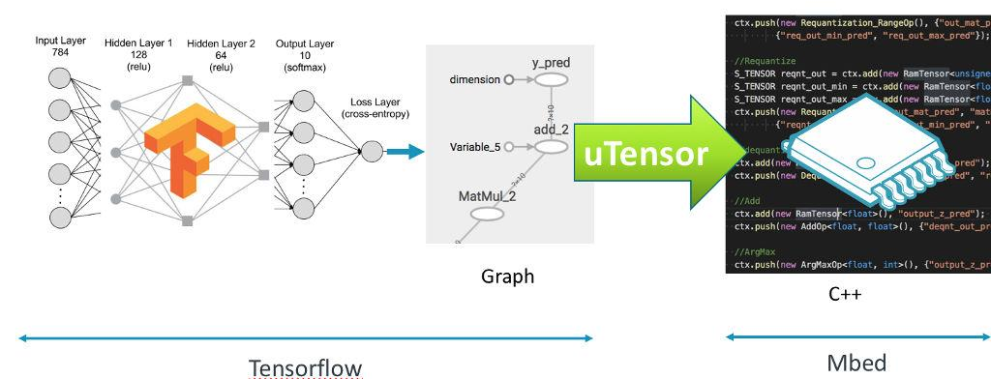
uTesnor
https://github.com/uTensor/uTensor
Notes:
A model is constructed and trained in Tensorflow.
uTensor takes the model and produces a .cpp and .hpp file.
These files contains the generated C++11 code needed for inferencing.
Working with uTensor on the embedded side is as easy as copy-and-paste.

Slide 40
uTensor
#include "models/deep_mlp.hpp"
...
Context ctx; //creating a context
...
//preparing for the input tensor
...
get_deep_mlp_ctx(Context& ctx, Tensor* input_0); //perform inference
ctx.eval();
S_TENSOR prediction = ctx.get({"y_pred:0"});
//getting the result

Slide 41
What is supported?
Currently available Ops and their quantized versions:
Add
ArgMax
Dropout
MatMal
Max
Min
Placeholder
Quantization Ops
ReLu
Reshape
Many exciting features are on the way:
Convolution
Pooling
CMSIS-NN integration
Smaller binary
More efficient Run-time
http://www.gierad.com/projects/supersensor/

Slide 42
Other Players
uTesnor
INFXL
Accuracy | 0.93 | 0.96
INFXL deep net (Cortex-M4) |  | 0.1 kB
uTensor code (C++) | 21 kB
Weights | 637 kB | 15 kB | 42x
MNIST: Popular hand-written numeral image dataset

Slide 43
Use Cases
Notes:
Use CS

Slide 44
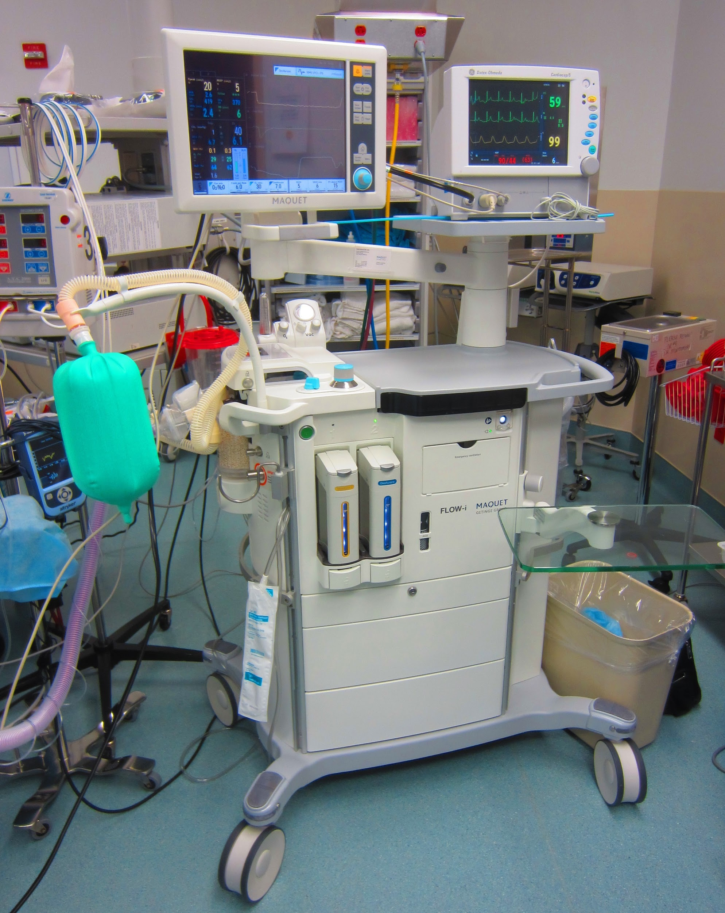
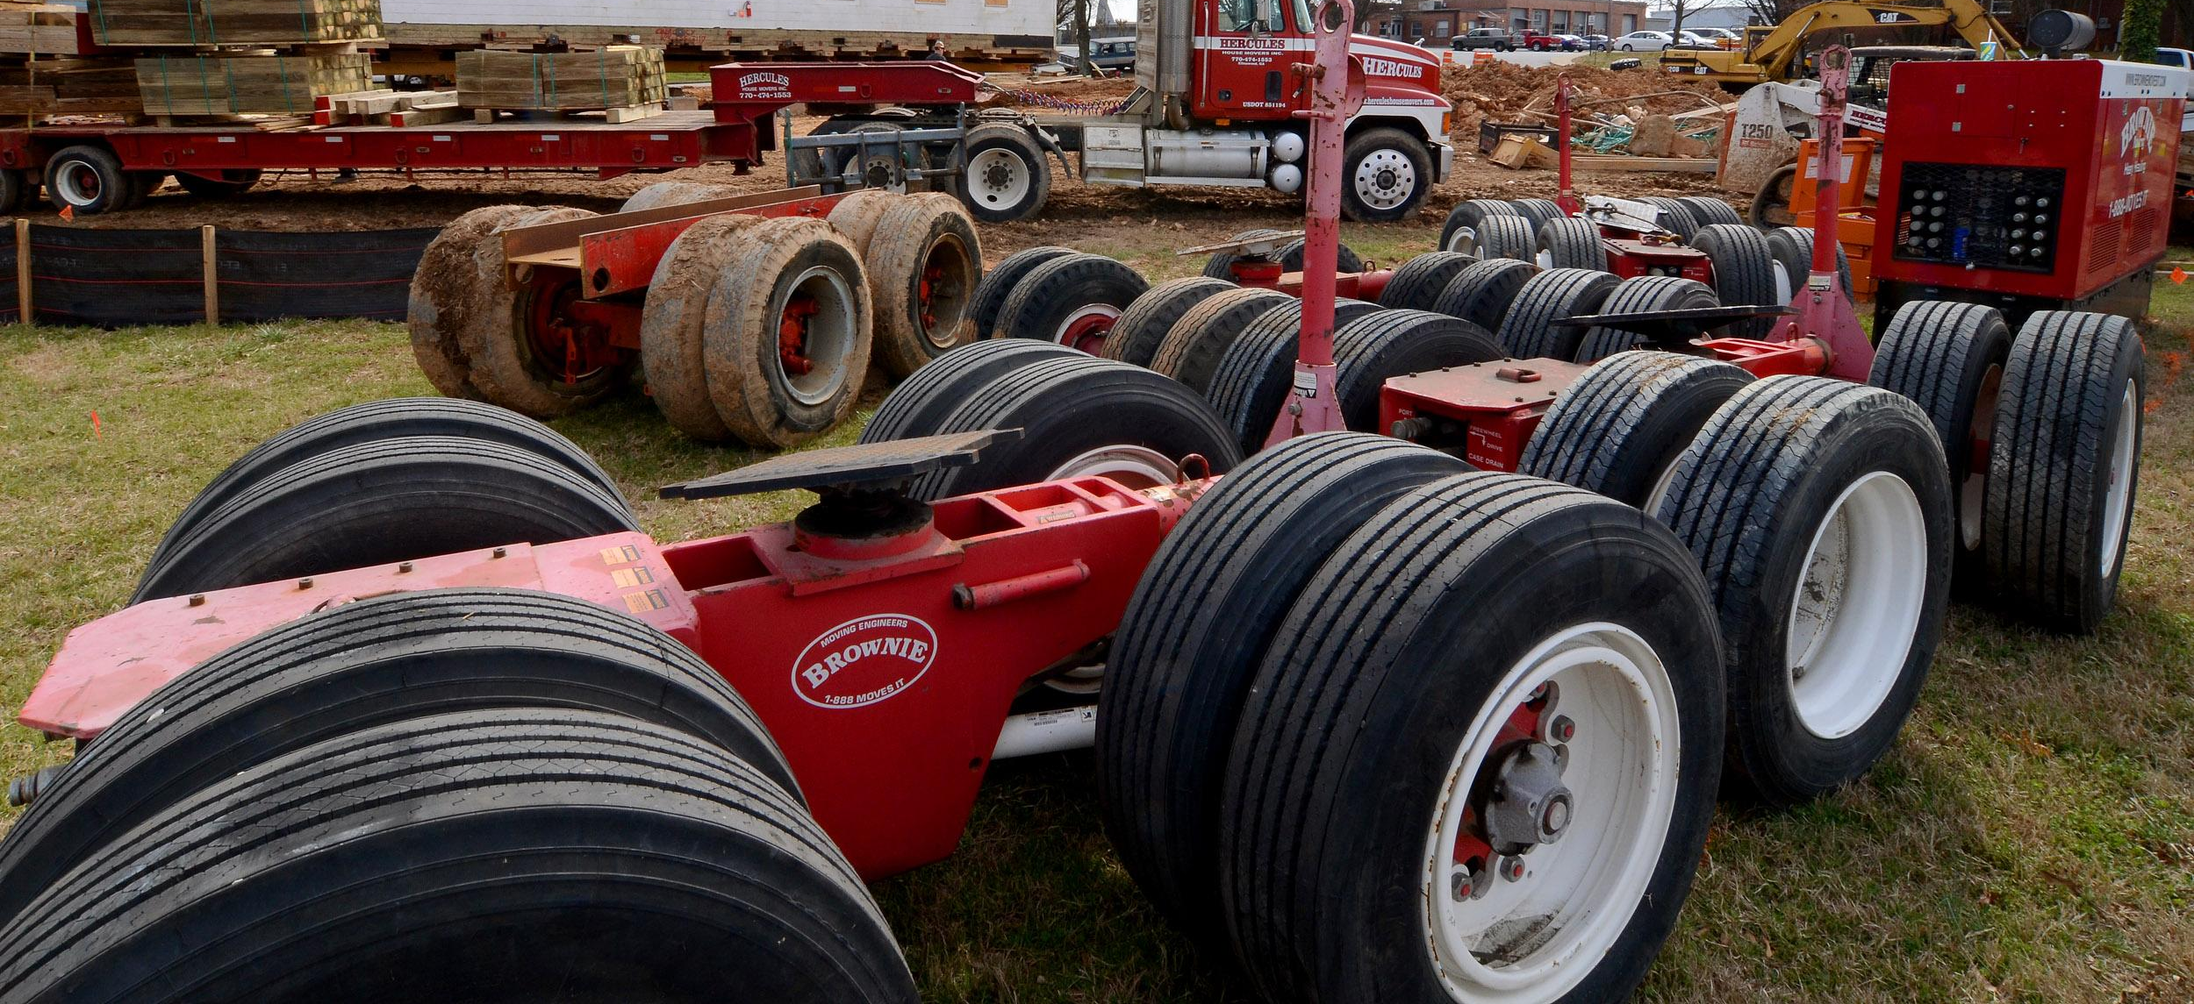
Use Case I: Machine Condition Monitoring
Objective: Ensure optimal machine performance and high availability by identifying developing faults before they become major failures.

Slide 45
Machine Condition Monitoring
Method:
Ultra-low power edge inference
Cut down on frequency and amount of data uploaded by edge devices.
Run inexpensive hardware while operating on µWs of battery power
Translate insights received from a multitude of sensors into decisions rapidly while employing a minimum of resources.

Slide 46
Machine Condition Monitoring
Gives early warning of impending machine failure, even before the symptoms become obvious.
preventing catastrophic failures and unexpected stoppages.
Makes critical decisions based on sensor data coming out of electronic, electrical, mechanical and electro-mechanical systems.
AI on edge looks for suspect patterns in data and notifies the operator in case one is found.

Slide 47
Case Study: Predict failure of air pressure system of heavy trucks
Goal: Predict the imminent failure of a safety-critical part in the air pressure system of heavy trucks.
Method: Sensor data, consisting of 170 attributes (comprising single-element values and histograms), were used to train an module for predicting imminent failures.
Dataset: consisted of 76,000 instances.
Accuracy: Predict failure in air pressure system with 68% recall and 79% precision.
HW: Run on an inexpensive MCU like the ARM Cortex-M0, requires only 133 kB of memory and can operate on as low as 93 µW of battery power.
www.infxl.com

Slide 48
Use Case II: Human Activity Recognition
Objective:
Predicting movement of a person based on sensor data. Do all their processing locally and therefore avoid data privacy and security issues.

Slide 49
HW for Human Activity Recognition
Smart phones and other personal tracking devices used for fitness and health monitoring are cheap and ubiquitous.
An increase of 28.4% in shipments of Intelligent Wearables in 2018, while the traditional wearable market saw a steep 9.2% decrease.
Over $172.2M units sold during 2018. 31.4% up from the previous year.
Smartwatches together grew 54.3%in 2018
Apple, Xiaomi, Huawei and Fitbit are investing a lot.

Slide 50
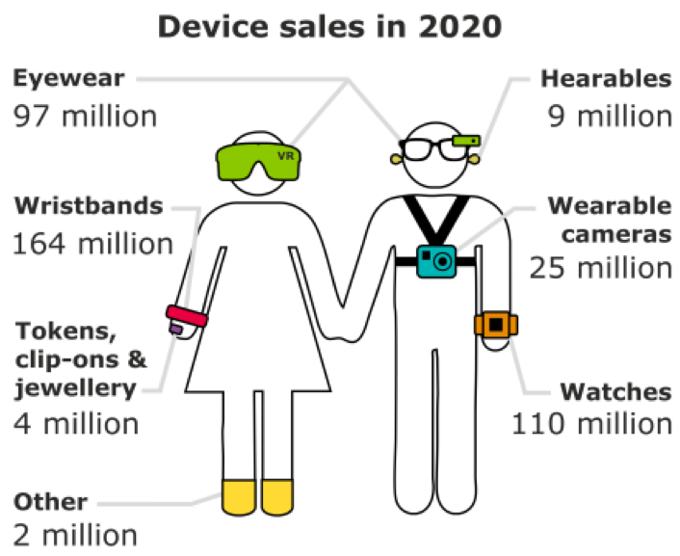
Future of HW for Human Activity Recognition
Forecasts: 411 million smart wearables worth $34 billion to be sold in 2020
From 84 million in 2015.
@ccinsight

Slide 51
Human Activity Recognition
Method:
Ultra-low power edge inference
Cut down on frequency and amount of data uploaded by edge devices.
Run inexpensive hardware while operating on µWs of battery power
Translate insights received from a multitude of sensors into decisions rapidly while employing a minimum of resources.

Slide 52
ML for Human Activity Recognition
HAR: a challenging multivariate time series classification task.
Walking, talking, standing, and sitting
Historically expensive to collect sensor data; requiring custom HW.
Involves predicting movement of a person based on sensor data.
Traditionally involves deep domain expertise and methods from signal processing to correctly engineer features from raw data in order to fit a machine learning model.
CNNs and RNNs have shown capable and even achieve state-of-the-art results by automatically learning features from the raw sensor data.
CNNs and LSTMs, and perhaps both together, are best suited to learning features.
Streams of sensor data are split into subs-sequences called windows, and each window is associated with a broader activity.

Slide 53
Case Study: Classify Human Activity Recognition
Goal: Determine the state of a person from among laying, sitting, standing, walking, walking downstairs, and walking upstairs based on sensor data from a smartphone.
Method: Triaxial acceleration and triaxial angular velocity readings were used to train a module for recognizing the activity.
Dataset: More than 10,000 time-series instances used to train and test.
Accuracy: Classify activity with an accuracy of 95%.
HW: Run on an inexpensive MCU like the ARM Cortex-M0, requires only 3 kB of memory while operating on µWs of battery power.
www.infxl.com

Slide 54
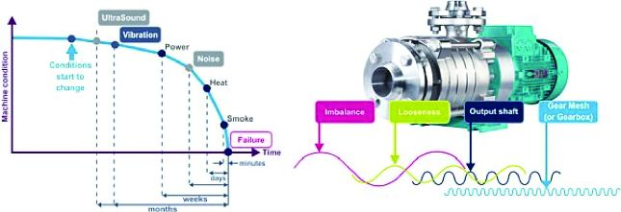
Use Case III: Condition Monitoring and Predictive Maintenance
Objective:
Identify the state of any machine in real time.
Save time & money by switching from corrective,
preventive, zero-hour, or periodic maintenance to predictive maintenance.

Slide 55
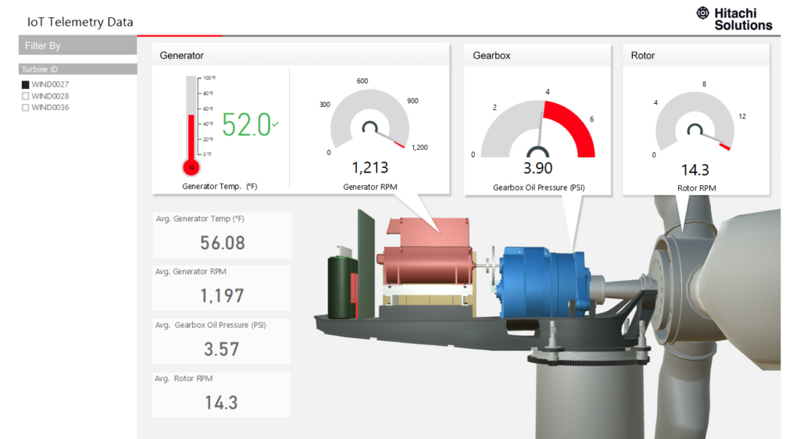
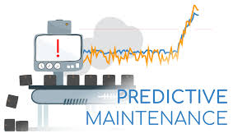

Slide 56
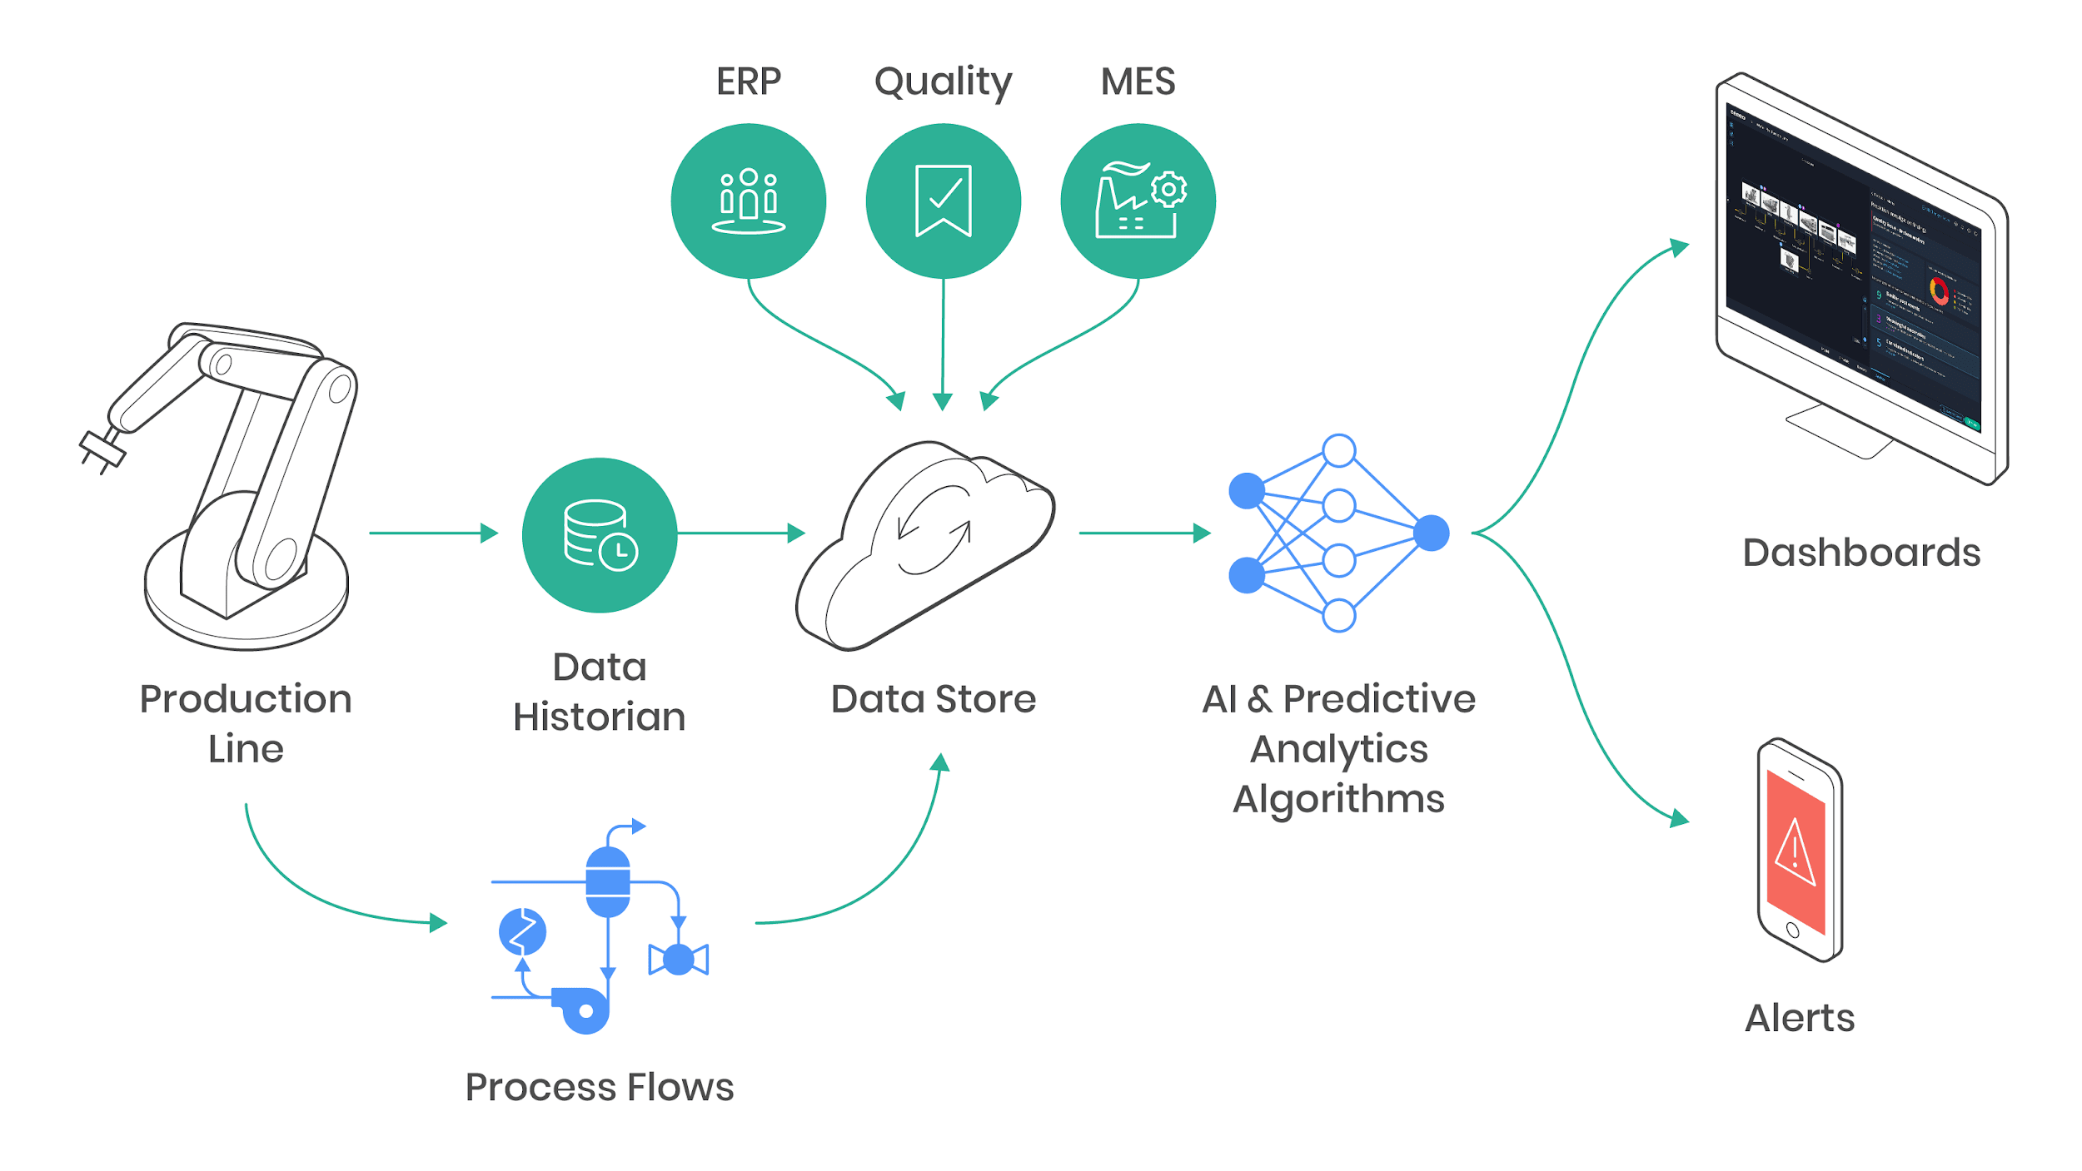

Slide 57
Condition Monitoring and Predictive Maintenance
Requires customization to specific machine type and function.
Has been successfully used for pumps, conveyors, valves and motors - so far.
Uses accelerometers, vibration sensors, and or sound, depending on specific use case.
Time-to-Failure Prediction
Identify the state of wear and predict time left before required maintenance.
Anomaly Detection
Detect unusual patterns on mechanicals, in real-time using vibration, sound or other sensors.

Slide 58
Condition Monitoring and Predictive Maintenance
Predictive maintenance on edge increases availability and scheduling flexibility.
Continuous monitoring of data coming out of a complex system, making an ML model which looks for suspect patterns in that date. Then notify maintenance team if case one is found.
Sensors:
Accelerometry
Vibration
Temperature
Sound
RPM
Electrical
Proprietary sensors
Image
Pressure

Slide 59
Case Study: Predicting Failure of Aircraft Turboprop Engines Ahead of Time
Goal: Predict engine failure during next 1-15, 16-30, or 30+ operational cycles.
Method: Use run-to-failure data from 21 sensors, including temperature, pressure, RPM, fuel flow, and others to train a module for predicting future failures.
Dataset: More than 34,000 histories.
Accuracy: Predict future failure of turboprop engines with 95% of accuracy.
HW: Run on an inexpensive MCU like the ARM Cortex-M0, requires only 17 kB of memory while operating on µWs of battery power.
www.infxl.com

Slide 60


Slide 61
References
https://www.epicor.com/en-us/resource-center/articles/what-is-industry-4-0/
https://www.forbes.com/sites/louiscolumbus/2018/06/11/10-ways-machine-learning-is-revolutionizing-supply-chain-management/#48f120833e37
https://www.eenewsanalog.com/news/mcu-market-reach-20-billion-2019
https://petewarden.com
https://petewarden.com/2019/04/14/what-machine-learning-needs-from-hardware/
https://ai.googleblog.com/2019/03/an-all-neural-on-device-speech.html
https://github.com/tensorflow/tensorflow/tree/master/tensorflow/lite/experimental/micro
Krishnamoorthi, R., 2018. Quantizing deep convolutional networks for efficient inference: A whitepaper. arXiv preprint arXiv:1806.08342.
https://www.ibm.com/blogs/research/2018/12/8-bit-precision-training/
https://github.com/google/gemmlowp
https://intel.github.io/mkl-dnn/index.html
www.infxl.com
http://www.gierad.com/projects/supersensor/
https://www.slideshare.net/janjongboom/machine-learning-on-microcontrollers-tech-power-summit-2018
https://github.com/uTensor/uTensor
http://www.gierad.com/projects/supersensor/

